Slide 1

VETRIPATHLEARN
Complete Offline Placement Preparation Portal & Native Mobile Application
Academic Technical Presentation • Department of Computer Science & Engineering

Slide 2

ABSTRACT
PROJECT ABSTRACT
• Concept & Mission: VetriPath is a self-contained hybrid education and assessment portal designed to prepare students for campus placements, technical interviews, and competitive exams.
• Offline-First Engineering: Eliminates network latency by embedding the web platform (HTML5/CSS3/ES6 JS) directly within an Android native WebView container, running 100% offline.
• Multi-Modal Learning Modules: Provides Quantitative Aptitude, Logical Reasoning, Verbal Ability, an Interactive JavaScript Coding Sandbox, and placement Roadmaps.
• Exam Integrity Suite: Features client-side anti-cheating mechanisms including shortcut suppression, copy-paste blocking, and instant exam auto-submission upon window tab blur.
• Native Biometric Shield: Employs Jetpack Compose and Android Biometrics SDK to secure local performance logs and progress history.

Slide 3
SYSTEM ANALYSIS
SYSTEM ANALYSIS: Feasibility Study
• Technical Feasibility: Built on standardized web engines (HTML5/CSS3/ES6 JS) & native WebView interop. Zero network requests, 100% offline operational stability.
• Economic Feasibility: Serverless client-side architecture with zero database or server hosting fees. Developed using 100% open-source tools ($0 overhead).
• Operational Feasibility: Intuitive glassmorphic UI design requiring zero user training. Automated scoring, feedback, and history management ensure high adoption.

Slide 4
SYSTEM ANALYSIS
SYSTEM ANALYSIS: Existing System & Drawbacks
• Network Dependencies: Online portals (GeeksforGeeks, IndiaBIX, HackerRank) fail completely in low-bandwidth or rural regions.
• High Ads & Latency: Heavy ad banner networks slow down page rendering, consume high RAM, and distract study focus.
• Insecure Practice Sandbox: Traditional portals permit copy-pasting code, viewing Developer Console inspector (F12), and changing tabs during mock tests.

Slide 5
SYSTEM ANALYSIS
SYSTEM ANALYSIS: Proposed System & Benefits
• 100% Offline Asset Packaging: Direct asset integration inside Android APK assets directory. Zero loading latencies.
• Jetpack Compose Biometric Shield: Protects user data files using Android biometrics (Fingerprint/PIN prompts) prior to app load.
• Cheating Protection Suite: Monitors keyboard events & auto-submits mock exams immediately when tab switch or window blur occurs.

Slide 6
SYSTEM ANALYSIS
SYSTEM ANALYSIS: Scope of the Project
• Target Audience: Undergraduate & postgraduate students preparing for campus drives (TCS NQT, Infosys, Wipro, Accenture, CTS, product startups).
• Module Coverage: Quantitative Aptitude (14 topics), Logical Reasoning (9 topics), Verbal Ability (7 topics), JS Coding Sandbox, Timed Mock Exams, Roadmaps.
• Platform Support: Cross-platform accessibility across mobile viewports, tablet screens, and desktop web environments.

Slide 7
SYSTEM SPECIFICATION
SYSTEM SPECIFICATION: Hardware & Software
Software Configuration
• Operating System: Android 8.0 (API 26) or higher for APK; Windows 10/11 for Web
• Core Languages: Kotlin 1.9, Java (Android SDK), JavaScript (ES6+), HTML5, CSS3
• Frameworks & SDKs: Jetpack Compose, Android Jetpack Biometrics SDK, WebView Engine
• Tools & Compilers: Android Studio Hedgehog, VS Code, Gradle Build Tool, Python 3.10+
Hardware Configuration
• Development Unit: Intel Core i5 / AMD Ryzen 5, 8 GB RAM (16 GB recommended), 10 GB storage
• Testing Device: Android Smartphone with Biometric Sensor (Fingerprint/PIN), Touch screen interface
• Client Display: Desktop resolution 1366x768 pixels; mobile viewports min 360x640 pixels

Slide 8
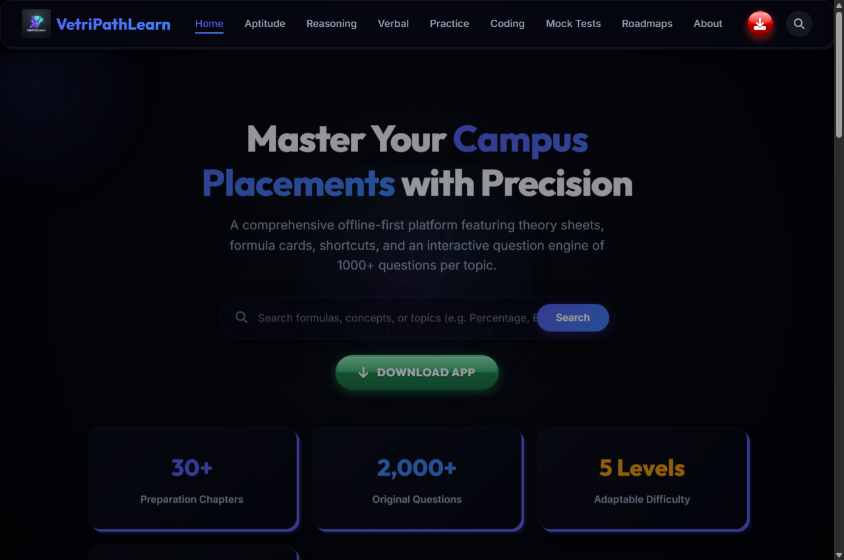
SYSTEM DESIGN - MODULE SPECIFICATION (INDEX.HTML)
Dashboard UI Console
Overview & Purpose: Main control center rendering overall progress, total available questions (2000+), solved metrics, and action cards.
📥 USER INPUT SPECIFICATIONS
• Navigation Clicks: Selects module links from header or drawer.
• Quick Action CTAs: Clicks 'Start Practice' or 'Take Mock Exam' cards.
• Theme Mode Switch: Toggles light/dark interface style icon button.
📤 SYSTEM OUTPUT SPECIFICATIONS
• Metric Cards: Displays available questions count (2000+) and solved metrics.
• Progress Bar: Visual completion percentage meter from LocalStorage.
• Feature Tiles: Interactive topic tiles with direct routing.
📱 REAL UI SCREENSHOT: index.html

Slide 9
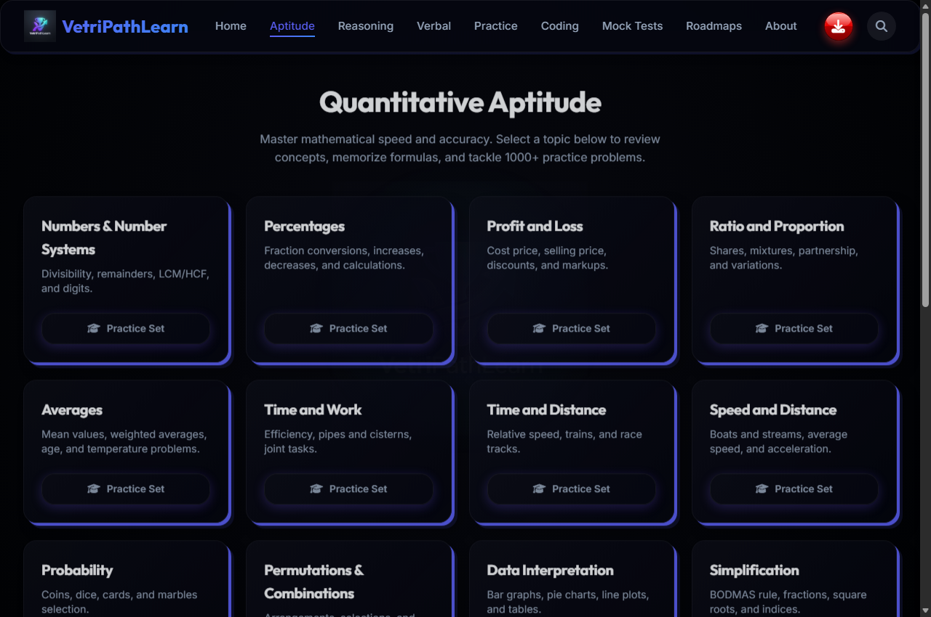
SYSTEM DESIGN - MODULE SPECIFICATION (APTITUDE.HTML)
Quantitative Aptitude Module
Overview & Purpose: Provides mathematical problem-solving practice across 14 core topics with formula Guides.
📥 USER INPUT SPECIFICATIONS
• Topic Selection: Selects mathematical topic from category drawer.
• Option Radio Click: Clicks option choice (A, B, C, or D) for a question.
• Solution Toggle: Clicks 'Show Solution' button to view formula breakdown.
📤 SYSTEM OUTPUT SPECIFICATIONS
• Formula Reference: Displays mathematical formulas at top of topic.
• Instant Verdict: Highlights chosen option green (Correct) or red (Incorrect).
• Step-by-Step Rationale: Shows detailed step-by-step mathematical breakdown.
📱 REAL UI SCREENSHOT: aptitude.html

Slide 10
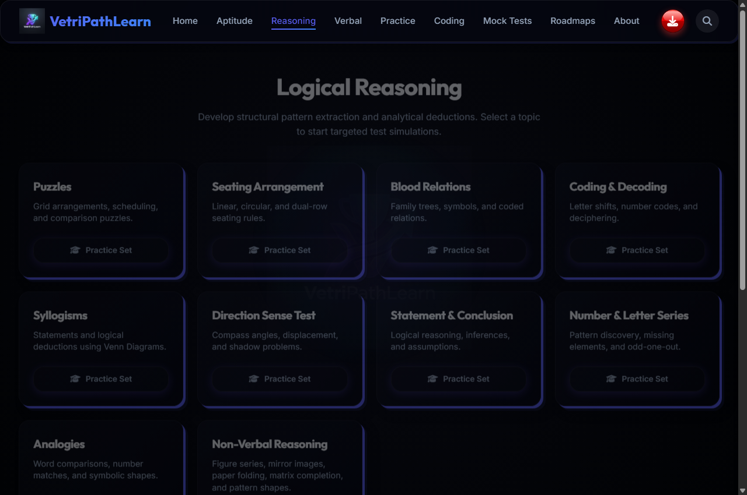
SYSTEM DESIGN - MODULE SPECIFICATION (REASONING.HTML)
Logical Reasoning Module
Overview & Purpose: Focuses on analytical ability, pattern identification, and deduction across 9 topics.
📥 USER INPUT SPECIFICATIONS
• Reasoning Category: Chooses topic (Blood Relations, Syllogisms, Coding-Decoding).
• Answer Selection: Clicks answer choice matching logical deduction.
• Rule Sheet Toggle: Clicks 'View Reasoning Rules' button.
📤 SYSTEM OUTPUT SPECIFICATIONS
• Rule Box: Renders analytical guidelines and family tree rules.
• Immediate Validation: Highlights correct answer choice and marks wrong attempt.
• Logic Breakdown: Displays step-by-step logical deduction explanation.
📱 REAL UI SCREENSHOT: reasoning.html

Slide 11
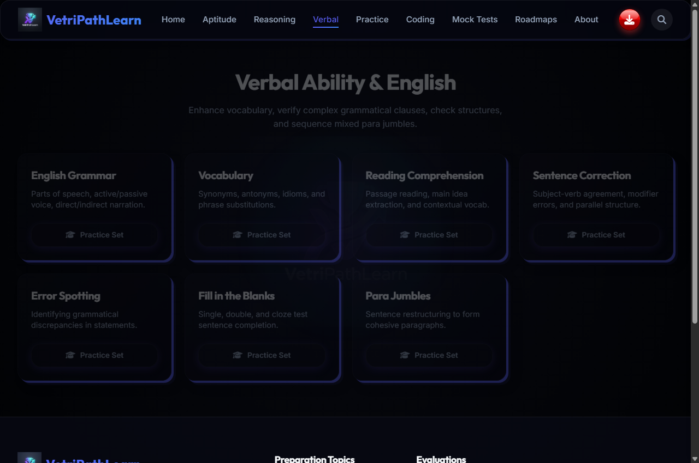
SYSTEM DESIGN - MODULE SPECIFICATION (VERBAL.HTML)
Verbal Ability Module
Overview & Purpose: Enhances English vocabulary, grammar accuracy, and comprehension skills across 7 topics.
📥 USER INPUT SPECIFICATIONS
• Sub-category Choice: Selects verbal module (Grammar Rules, Error Spotting).
• Choice Selection: Clicks selected multiple-choice answer option.
• Passage Navigation: Scrolls and reads comprehension text passages.
📤 SYSTEM OUTPUT SPECIFICATIONS
• Grammar Tip Card: Presents essential English usage rules before questions.
• Answer Feedback: Shows immediate correctness indicator with explanation.
• Contextual Rationale: Explains why specific option is grammatically sound.
📱 REAL UI SCREENSHOT: verbal.html

Slide 12
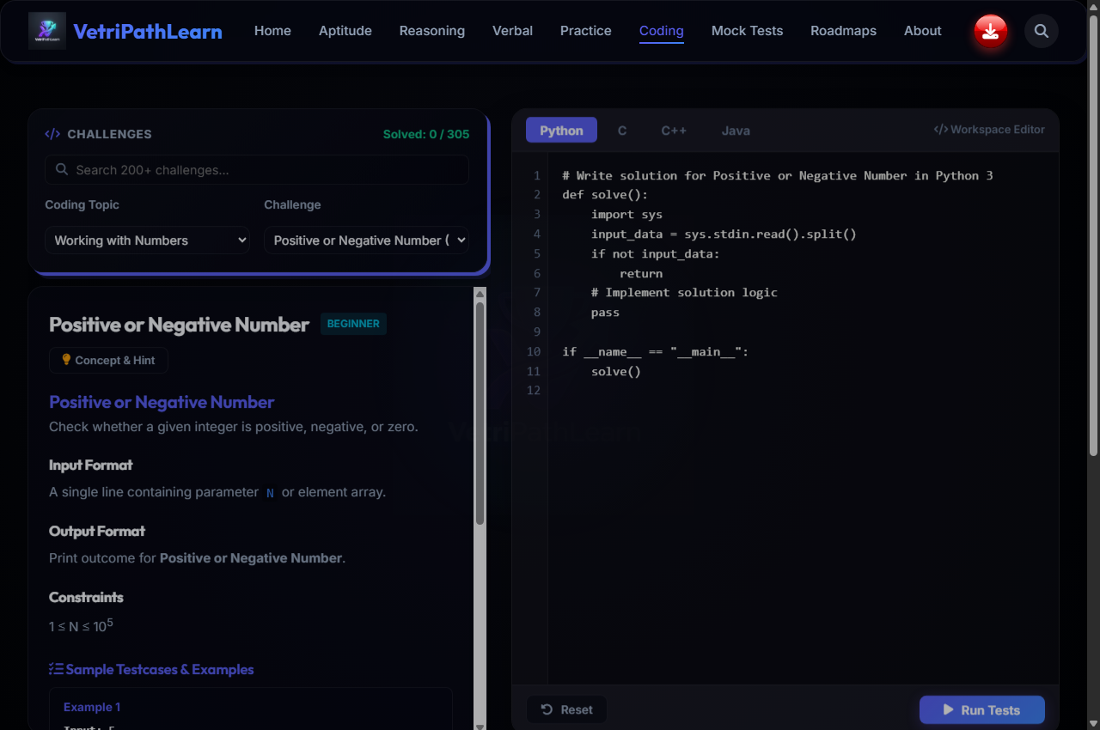
SYSTEM DESIGN - MODULE SPECIFICATION (CODING.HTML)
Interactive Coding Workstation
Overview & Purpose: Client-side JavaScript execution sandbox allowing candidates to write and test code.
📥 USER INPUT SPECIFICATIONS
• Problem Selector: Picks problem (Two Sum, Palindrome Check, Array Reverse).
• Code Editor Input: Writes or edits JavaScript code inside interactive text area.
• Run Code Trigger: Clicks 'Execute Code' trigger to compile script.
📤 SYSTEM OUTPUT SPECIFICATIONS
• Console Output (stdout): Captures and displays console.log output and return values.
• Test Case Badges: Displays PASS / FAIL status for default test inputs.
• Runtime Error Log: Displays syntax error messages or stack trace logs.
📱 REAL UI SCREENSHOT: coding.html

Slide 13
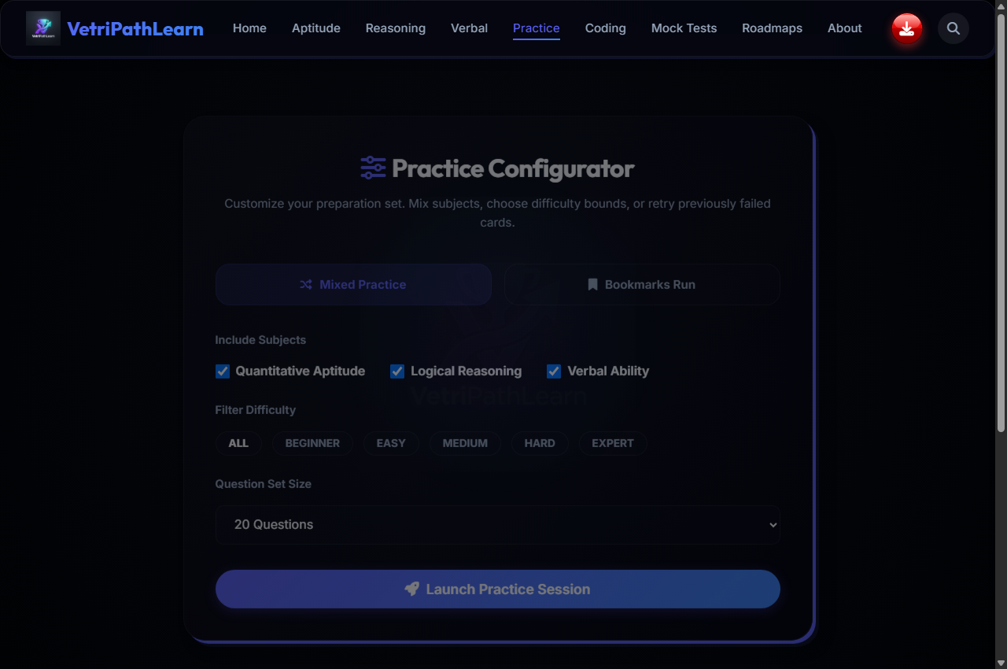
SYSTEM DESIGN - MODULE SPECIFICATION (PRACTICE.HTML)
Practice Hub Topic Directory
Overview & Purpose: Central directory listing all topics with multi-category tabs and search filters.
📥 USER INPUT SPECIFICATIONS
• Category Filter Tabs: Clicks 'All', 'Quantitative', 'Reasoning', 'Verbal', or 'Coding' tabs.
• Search Keyword Input: Types topic title or keyword into search bar.
• Topic Card Click: Clicks topic card to launch practice session.
📤 SYSTEM OUTPUT SPECIFICATIONS
• Filtered Grid: Renders topic cards matching selected tab and search query.
• Completion Badges: Shows completed question count vs total questions for each topic.
• Action CTAs: Provides 'Continue' or 'Start Fresh' buttons.
📱 REAL UI SCREENSHOT: practice.html

Slide 14
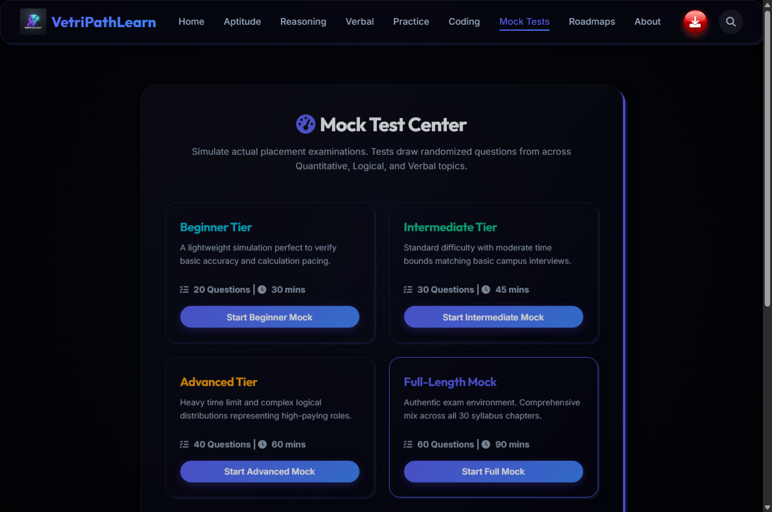
SYSTEM DESIGN - MODULE SPECIFICATION (MOCKTEST.HTML)
Mock Test Exam Simulator
Overview & Purpose: Timed corporate exam simulator with randomized question pools and tab blur auto-submit.
📥 USER INPUT SPECIFICATIONS
• Tier Setup: Selects tier: Easy (15m), Medium (30m), Hard (45m), Full-Length.
• Option Selection: Selects radio buttons for questions under timed environment.
• Tab Blur / Switch: Candidate switches browser tab or minimizes window during test.
📤 SYSTEM OUTPUT SPECIFICATIONS
• Live Timer & Grid: Renders ticking countdown clock and question state palette.
• Security Modal & Auto-Submit: Triggers red security modal & auto-submits exam upon focus loss!
• Result Analytics: Displays final Score, Accuracy %, Time Taken, and detailed breakdown.
📱 REAL UI SCREENSHOT: mocktest.html

Slide 15

SYSTEM DESIGN - MODULE SPECIFICATION (BOOKMARKS.HTML)
Bookmarks Review Hub
Overview & Purpose: Dedicated review repository maintaining pinned questions across modules.
📥 USER INPUT SPECIFICATIONS
• Category Filter: Filters bookmarked questions by Subject.
• Remove Bookmark: Clicks trash icon on question card to unpin.
• Clear All Button: Clicks 'Clear All Bookmarks' with confirmation modal.
📤 SYSTEM OUTPUT SPECIFICATIONS
• Saved Question Cards: Displays full question prompt, choices, and stored correct answer.
• Empty State Graphic: Shows friendly illustration when no bookmarks are saved.
• Updated Local State: Removes unpinned questions from LocalStorage array instantly.
📱 REAL UI SCREENSHOT: bookmarks.html

Slide 16
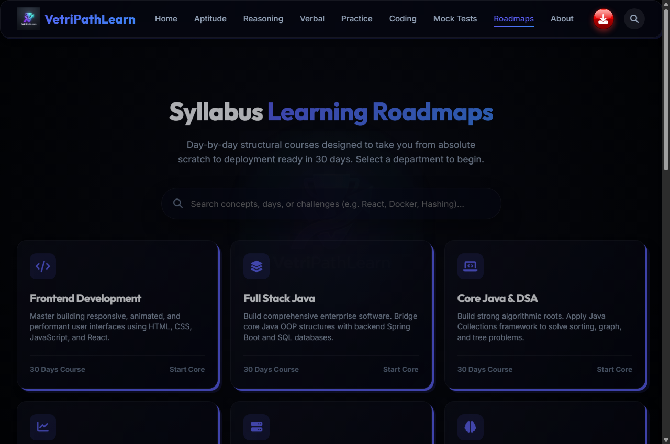
SYSTEM DESIGN - MODULE SPECIFICATION (ROADMAP.HTML)
Placement Preparation Roadmap
Overview & Purpose: Structured 6-month preparation schedule checklist for campus placements.
📥 USER INPUT SPECIFICATIONS
• Track Filter: User chooses target profile (Product Companies, Service MNCs, Core).
• Milestone Checkbox: Checks off completed preparation tasks and topics.
📤 SYSTEM OUTPUT SPECIFICATIONS
• Timeline Grid: Renders 6-month roadmap stages from foundational math to mock interviews.
• Readiness Bar: Calculates overall career readiness progress percentage.
• Checklist State Sync: Persists checked milestone status in LocalStorage.
📱 REAL UI SCREENSHOT: roadmap.html

Slide 17
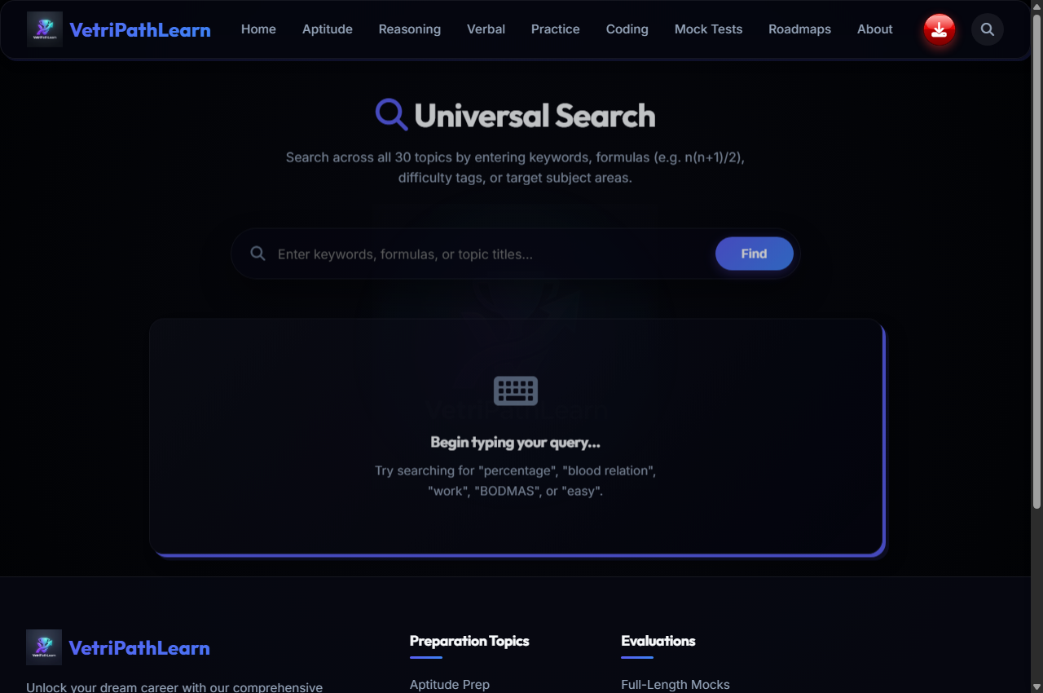
SYSTEM DESIGN - MODULE SPECIFICATION (SEARCH.HTML)
Global Search Index UI
Overview & Purpose: Enables real-time keyword search indexing across all 30+ topics.
📥 USER INPUT SPECIFICATIONS
• Search Input Text: Types search term (e.g. 'Percentage', 'Trees', 'Syllogism', 'Arrays').
• Filter Button: Clicks clear or topic category quick tag.
📤 SYSTEM OUTPUT SPECIFICATIONS
• Real-time Results: Instantly updates search results showing topic title and direct link.
• Zero Results Slate: Suggests alternative search terms if no matching topic is found.
📱 REAL UI SCREENSHOT: search.html

Slide 18
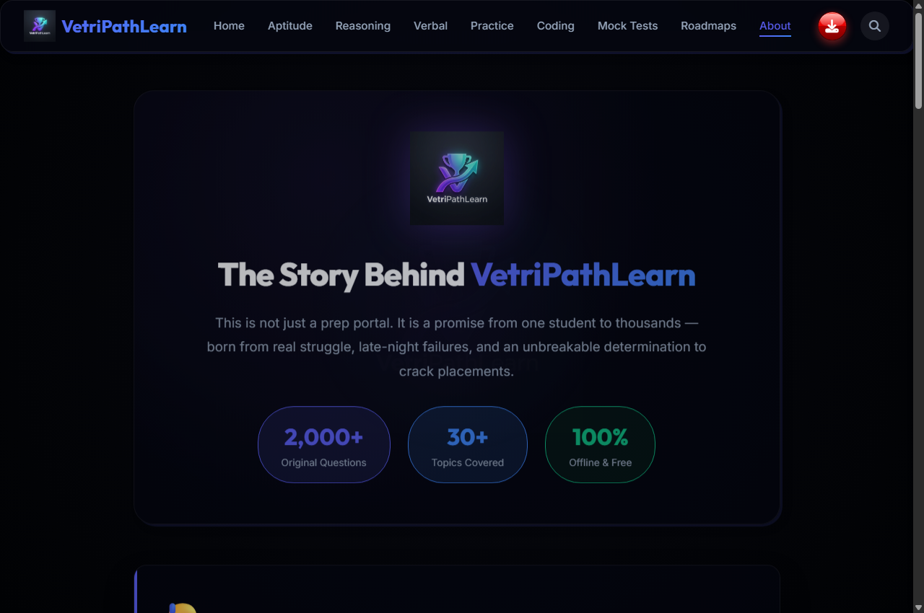
SYSTEM DESIGN - MODULE SPECIFICATION (ABOUT.HTML)
About VetriPath & Tech Stack
Overview & Purpose: Presents platform architecture, offline-first engineering principles, and tech stack.
📥 USER INPUT SPECIFICATIONS
• Theme Mode Switch: Clicks Dark Mode / Light Mode toggle icon.
• Feedback Link: Clicks developer contact or app review button.
📤 SYSTEM OUTPUT SPECIFICATIONS
• Architecture Summary: Highlights offline WebView benefits and biometric security integration.
• Tech Stack Badges: Displays HTML5, CSS3, JS ES6, Kotlin, Compose, and WebSockets badges.
• Global Theme Sync: Applies theme preference across all web pages.
📱 REAL UI SCREENSHOT: about.html

Slide 19
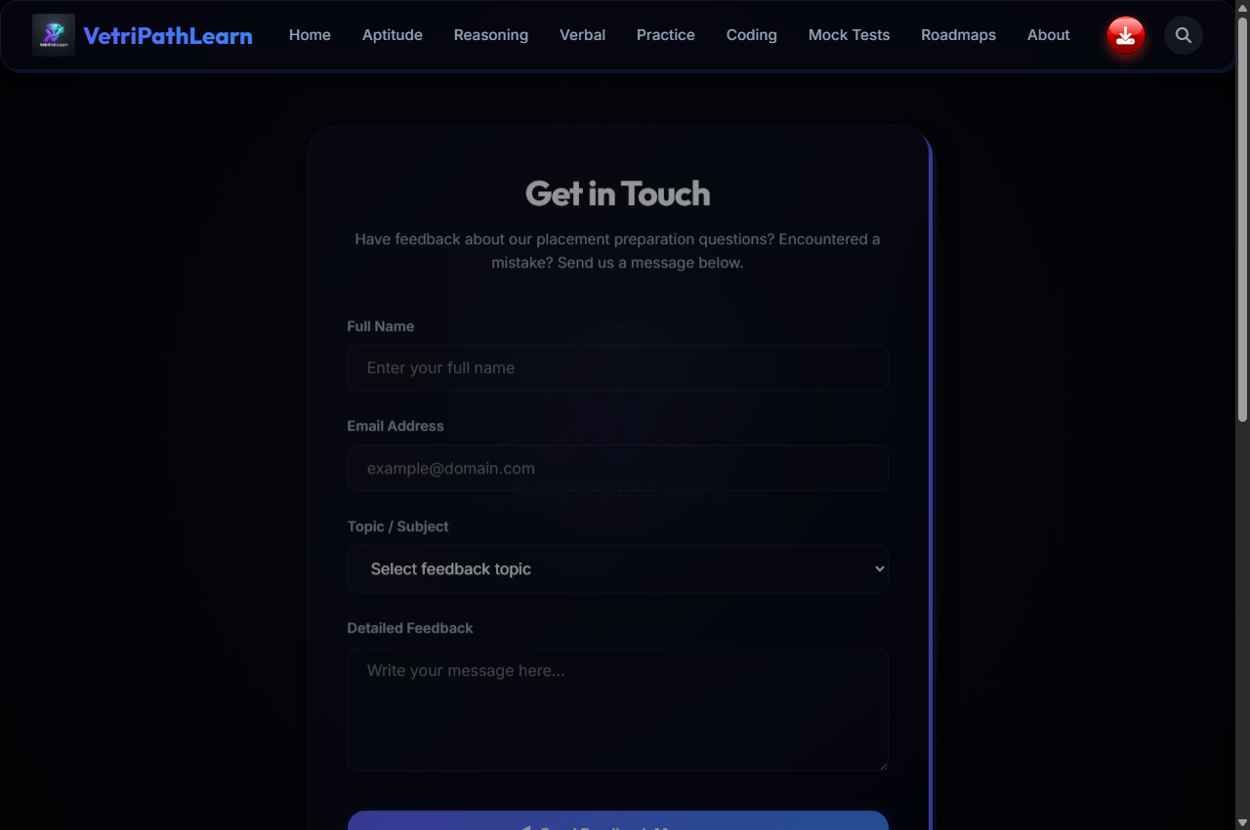
SYSTEM DESIGN - MODULE SPECIFICATION (CONTACT.HTML)
Contact & Feedback Form
Overview & Purpose: Provides an interactive user feedback form for reporting issues and feature requests.
📥 USER INPUT SPECIFICATIONS
• User Input Form: User inputs Name, Email ID, Feedback Category, and Message text.
• Submit Button Click: Clicks 'Submit Feedback' form button.
📤 SYSTEM OUTPUT SPECIFICATIONS
• Form Validation: Checks required fields and email formatting.
• Success Toast: Displays animated green toast: 'Feedback saved successfully!'
• Local Feedback Log: Saves feedback entry locally in browser storage.
📱 REAL UI SCREENSHOT: contact.html

Slide 20
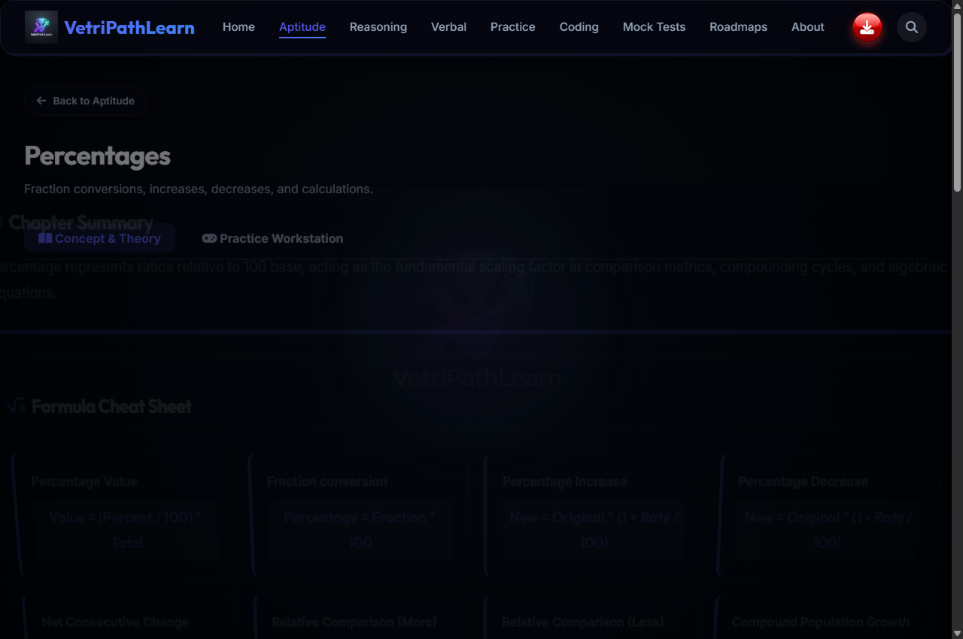
ACTIVE QUIZ ATTENDING
Quantitative Aptitude Active Practice Workstation
Candidate attending Percentages question, radio choice B selected, green correct answer feedback & formula breakdown visible.

Slide 21
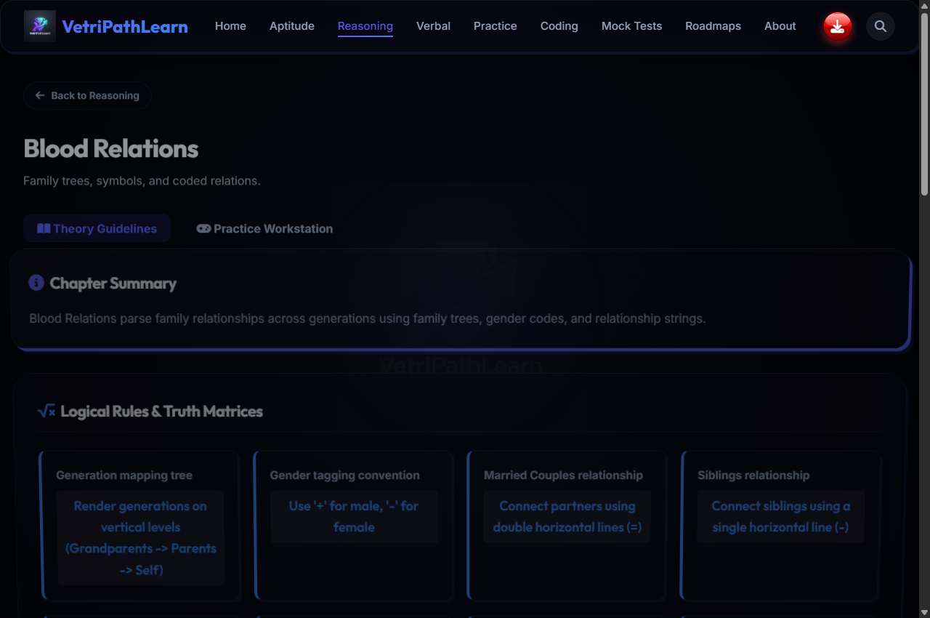
ACTIVE QUIZ ATTENDING
Logical Reasoning Active Practice Workstation
Candidate attending Blood Relations question, analytical family tree symbols, radio option selected & logic tree visible.

Slide 22
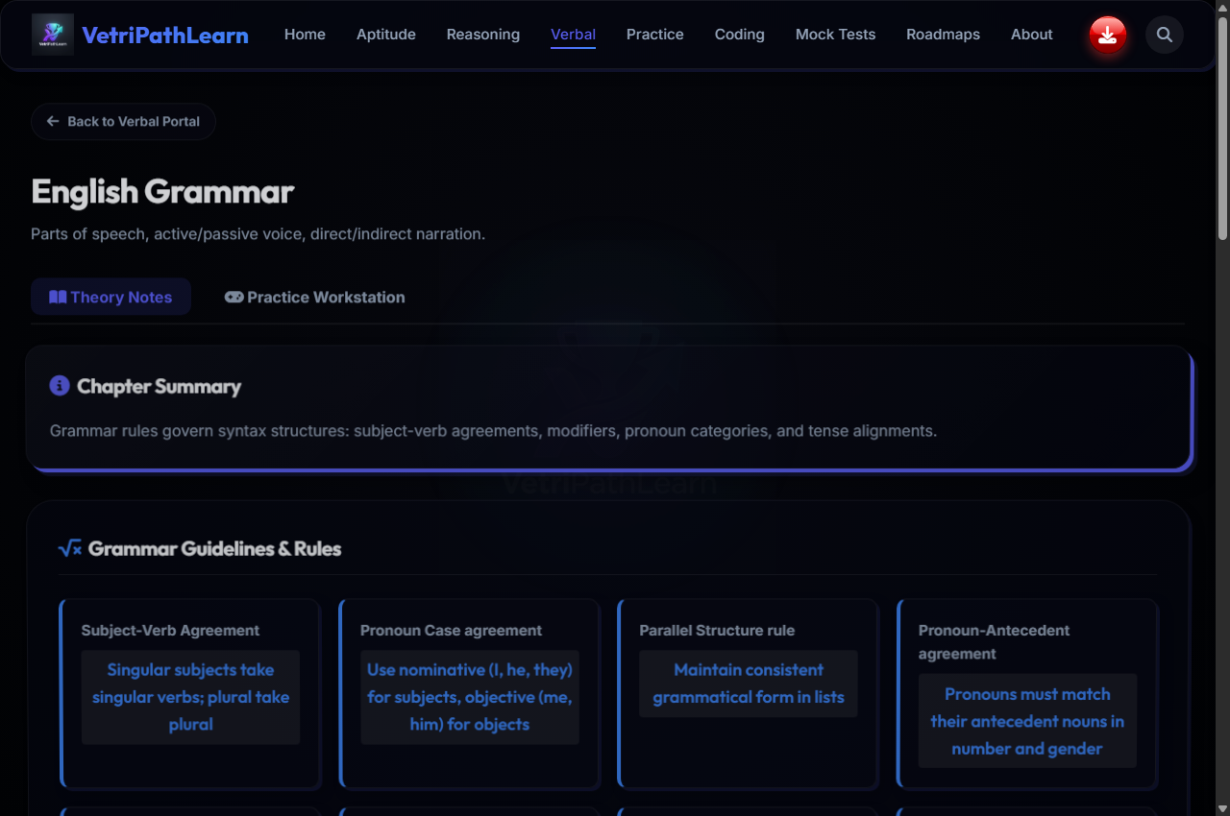
ACTIVE QUIZ ATTENDING
Verbal Ability Active Practice Workstation
Candidate attending Grammar Rules question, sentence option choice selected & subject-verb rationale expanded.

Slide 23

ACTIVE QUIZ ATTENDING
Interactive Coding Sandbox Active Execution Sample
Candidate editing Two Sum JavaScript solution, 'Execute Code' triggered, PASS/FAIL test badges & stdout console output visible.

Slide 24
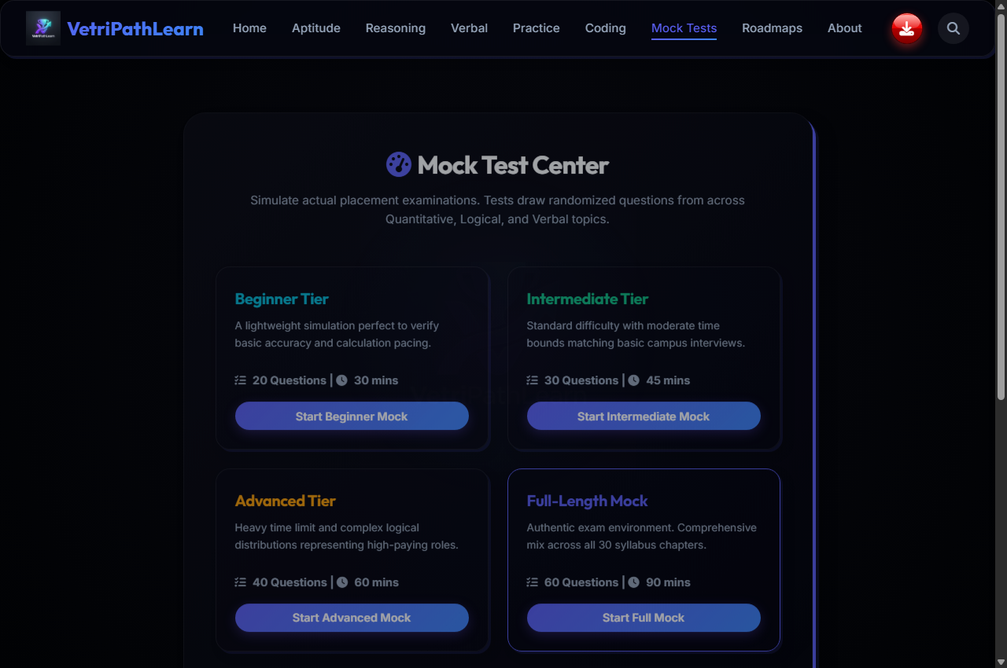
ACTIVE QUIZ ATTENDING
Timed Exam Simulator Active Test Workstation
Candidate taking 30-min placement mock exam, live countdown clock running, question palette grid active & tab blur monitor engaged.

Slide 25
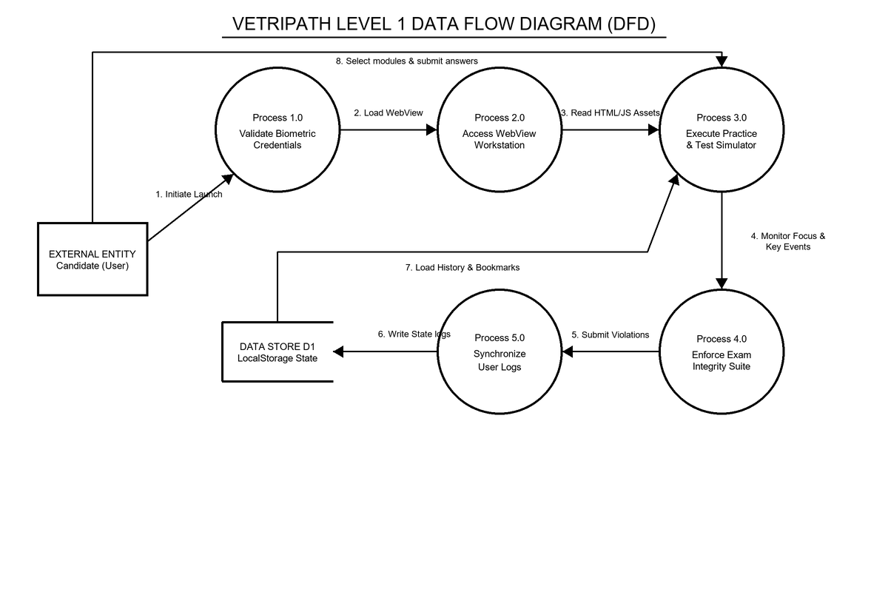
SYSTEM DESIGN
SYSTEM DESIGN: Level 1 Dataflow Diagram (DFD)
Level 1 Dataflow Diagram mapping candidate inputs through processes to LocalStorage.

Slide 26
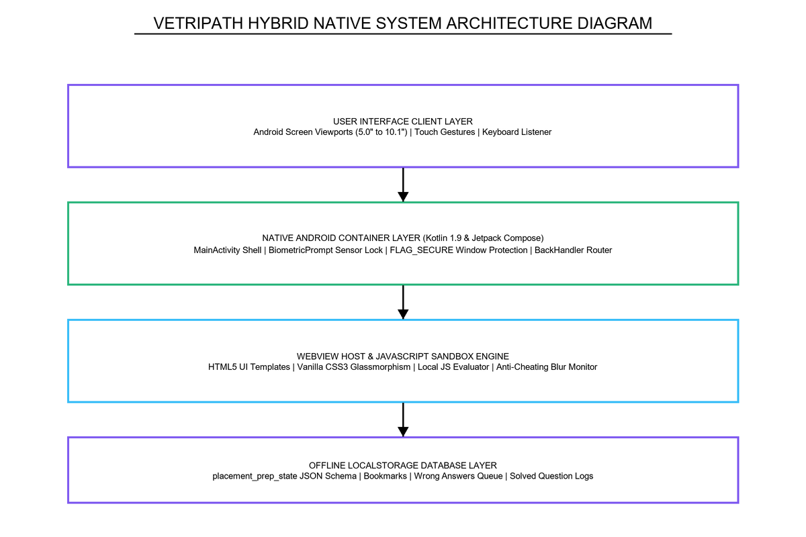
SYSTEM DESIGN
SYSTEM DESIGN: Hybrid System Architecture Diagram
4-Layer Hybrid Native Architecture: UI Layer -> Compose Shell -> WebView Host -> LocalStorage DB.

Slide 27
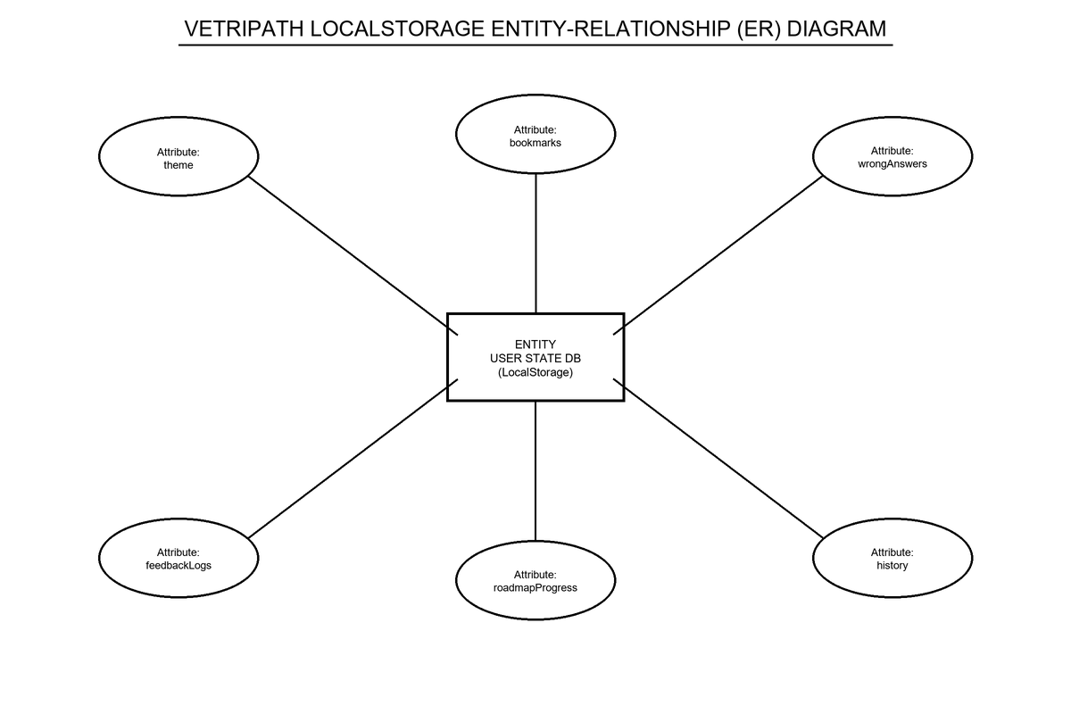
SYSTEM DESIGN
SYSTEM DESIGN: Database Schema (ER Diagram)
LocalStorage Entity-Relationship Diagram detailing JSON schema keys and parameters.

Slide 28
SYSTEM IMPLEMENTATION
SYSTEM IMPLEMENTATION: Coding Highlights
• Native Kotlin Security Shell: Applies FLAG_SECURE to prevent screenshots/recording and initializes BiometricPrompt scanner.
• JavaScript State Storage (storage.js): Consolidates getState(), updateState(), addBookmark(), and logSolvedQuestion() state hooks.
• Exam Anti-Cheating Suite: Monitors window blur and visibility state changes, auto-submitting exams upon focus loss.

Slide 29
SYSTEM TESTING
SYSTEM TESTING: Test Results Summary
• Biometric Authentication Lock: TC-01: Verified BiometricPrompt scanner overlays and PIN fallbacks [STATUS: PASS].
• Offline Airplane Mode Load: TC-02: Confirmed asset loading <50ms with zero network requests [STATUS: PASS].
• Exam Blur Auto-Submission: TC-03: Simulated window blur during active exam; 100% detection rate [STATUS: PASS].
• Shortcut & Context Menu Disable: TC-04: Confirmed suppression of Ctrl+C, Ctrl+V, Ctrl+U, F12 inspect keys [STATUS: PASS].

Slide 30
FUTURE ENHANCEMENTS
FUTURE ENHANCEMENTS & CONCLUSION
• Cloud Sync Middleware: Integration with Google Drive REST API for optional cloud backup and restore.
• AI Personal Analytics: Recommends targeted prep paths based on solved question difficulty scores.
• Peer-to-Peer Competitive Rooms: Online testing rooms and real-time scoreboards using WebSockets.
• Conclusion: Successfully developed a high-performance offline hybrid platform bridging the digital divide for students.

Slide 31
THANK YOU
"Walk the Path. Become the Victory. Inspire the World."

